Slide 1
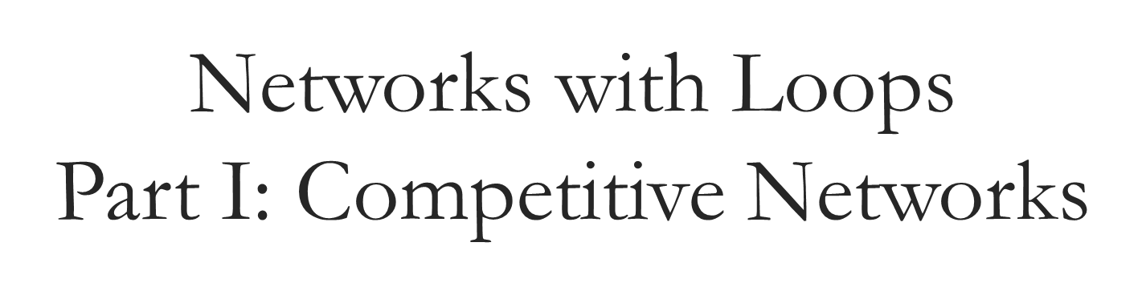

Slide 3
Networks with Loops (1) (More next time)
Issues: Synchronous and Asynchronous Update?
Converges or continues forever?
Inhibitory or Exhibitory weights (i.e. positive or negative)

Slide 4


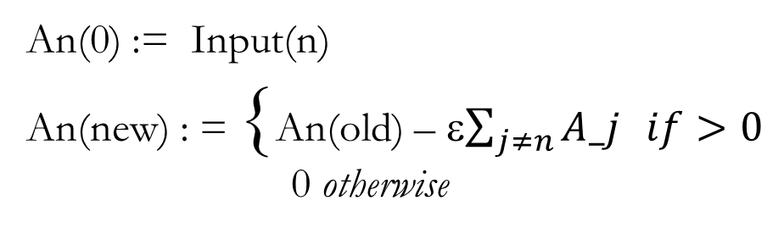
(MaxNet): Competitive Network
1
1
−ε
−ε
An(0) := Input(n)
An(new) : = {An(old) – ε$\sum_{j≠n}{A_j} if>0$
0 otherwise
−ε
−ε
−ε
−
−ε
−ε
−ε
−ε
−ε
1
1
−ε

Slide 5
Visualizing Weights and Vectors in Same Space

Slide 6
Hamming Net (assume bipolar for simplicity) 1. Pick number of cluster units. 2. STORE: Assign weights to cluster unit input weights (This gives address of cluster in data space.) 3. Give data point; value of cluster indicates number agree – number disagree. Largest value should be chosen cluster
MAXNET

Slide 7
What if you only know the number of clusters but not where they are in input space? (e.g. in non-uniform distribution)
Kohonen Net; finds by itself via self–organization the location of cluster points.

Slide 8
Self-Organizing Network
Weights from input give “location” to neuron
Kohonen algorithm results in “winner” neuron
After training, close input patterns have topologically close winners
Results in Equi-probable Continuous Mapping (without teacher)

Slide 10
Self-Organizing Network
Weights from input to neurons
Topology between neurons

Slide 11



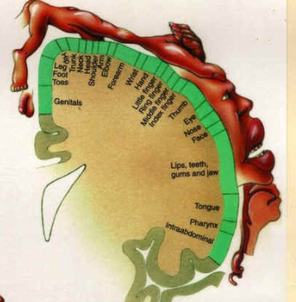



Slide 12
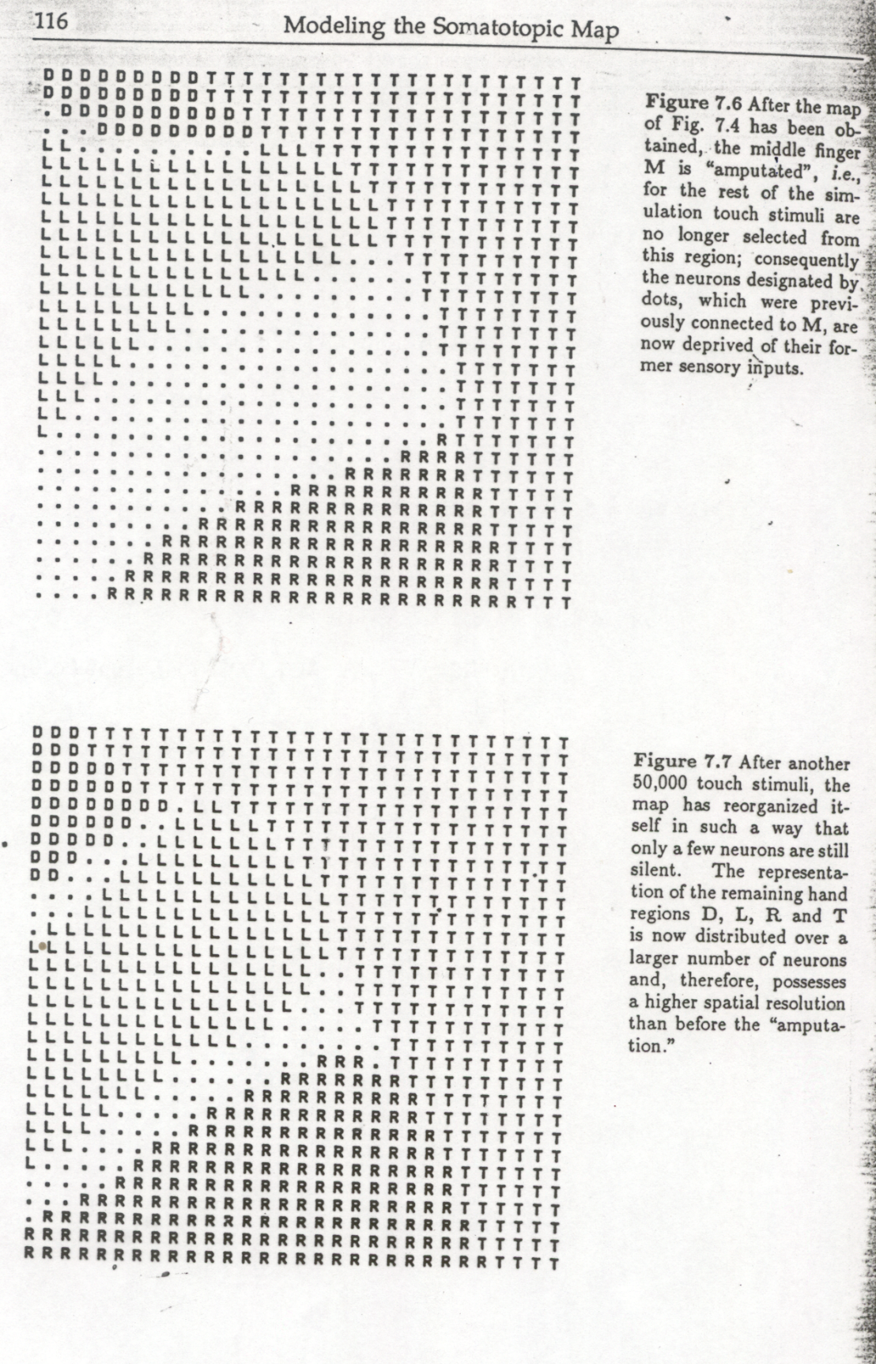

Slide 13
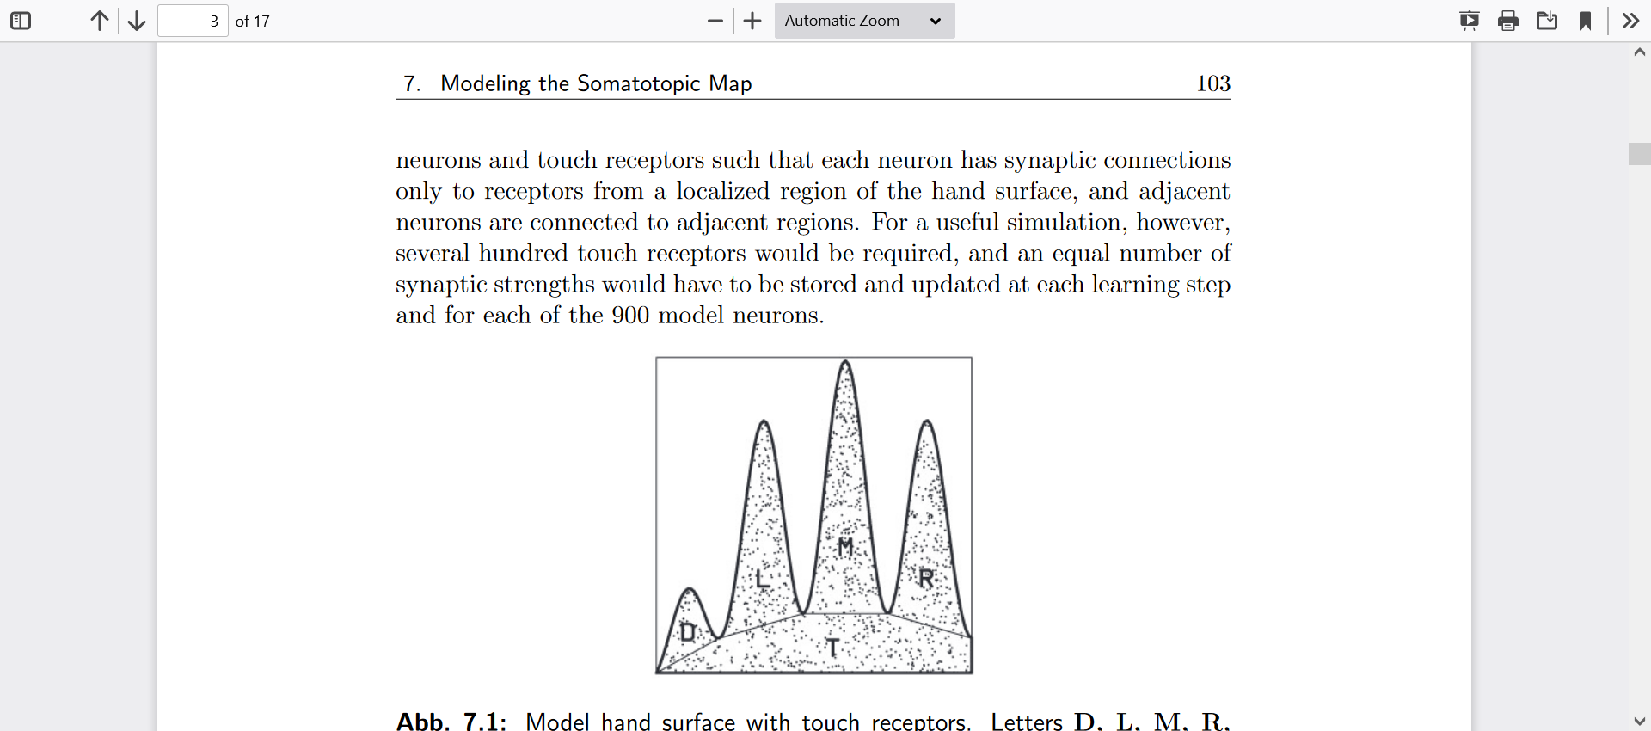

Slide 14
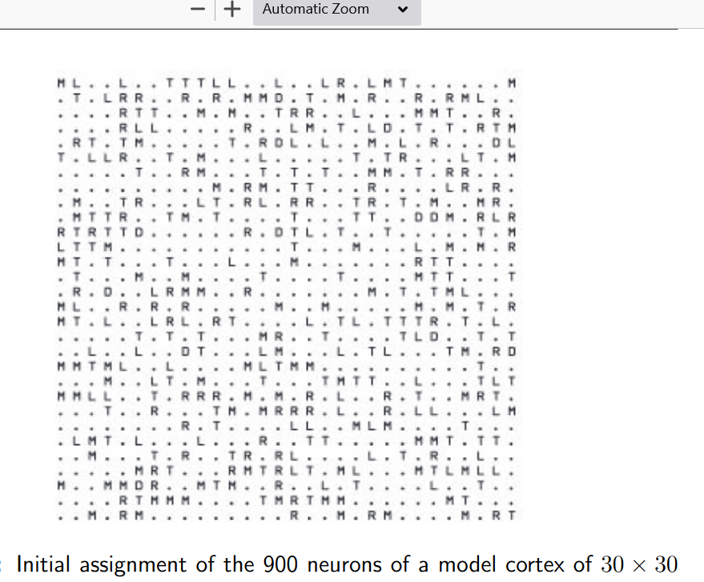

Slide 15
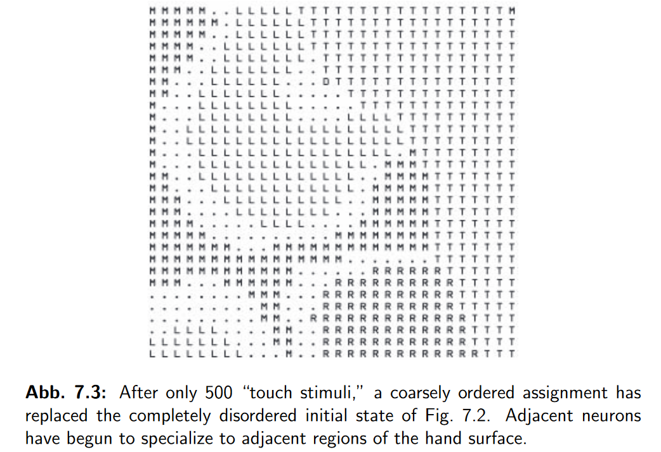

Slide 16
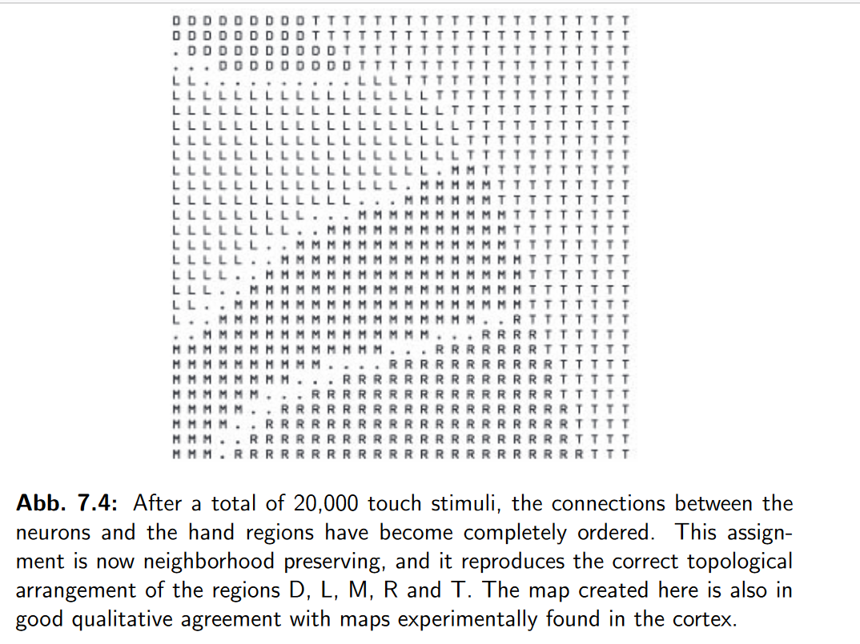

Slide 17
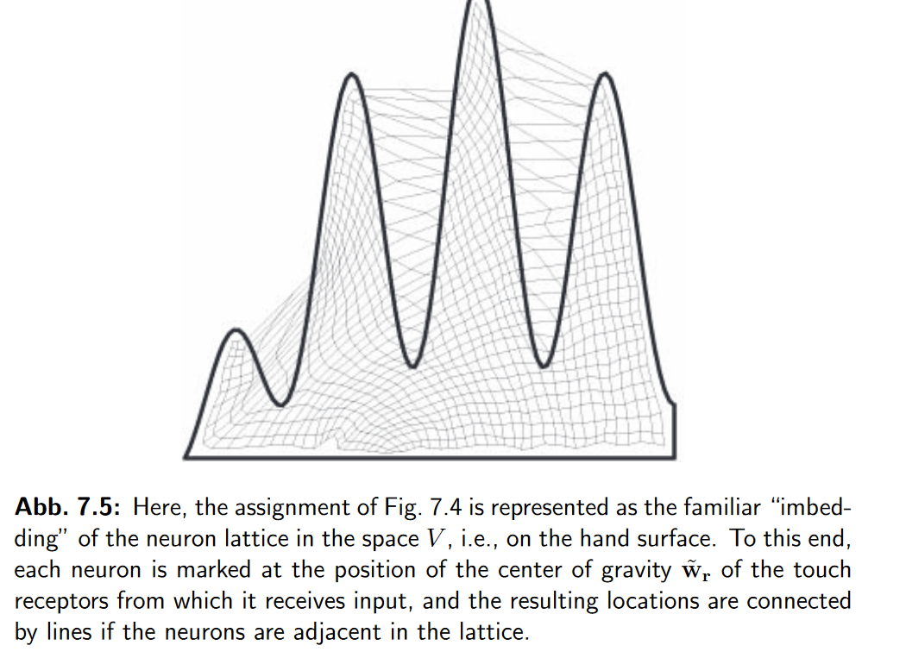

Slide 18
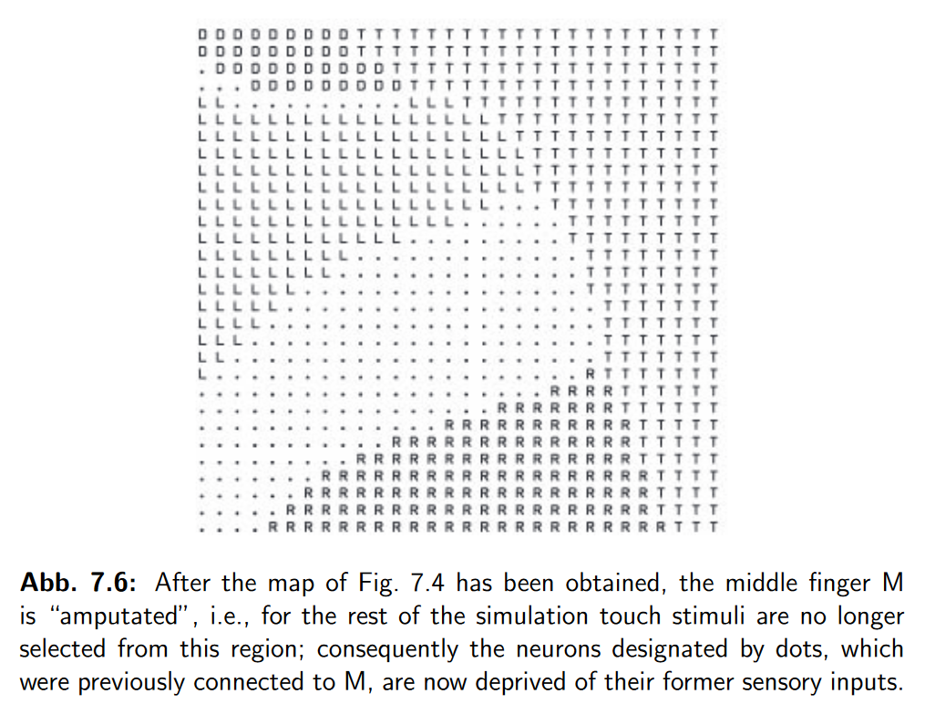

Slide 19
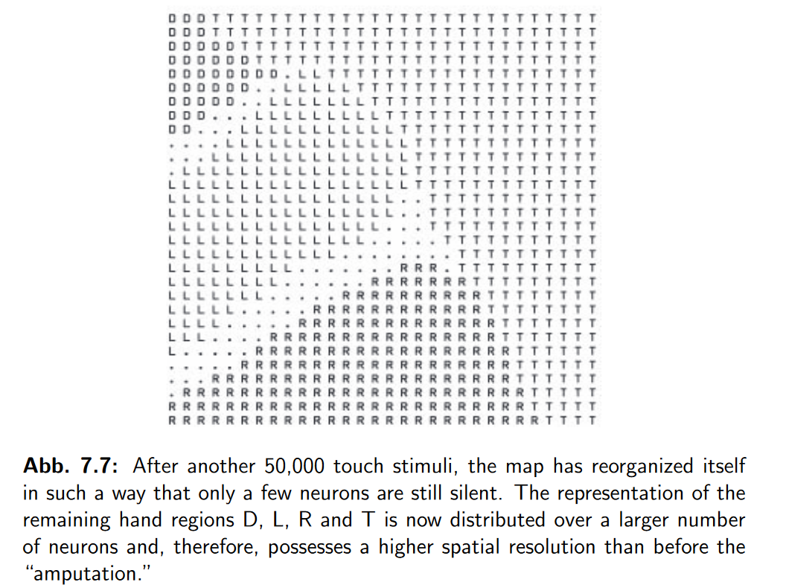

Slide 20
Go to Moodle Pdfs

Slide 21
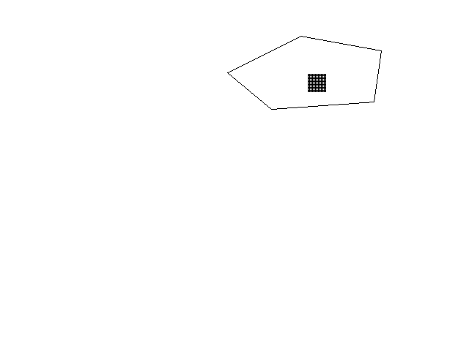
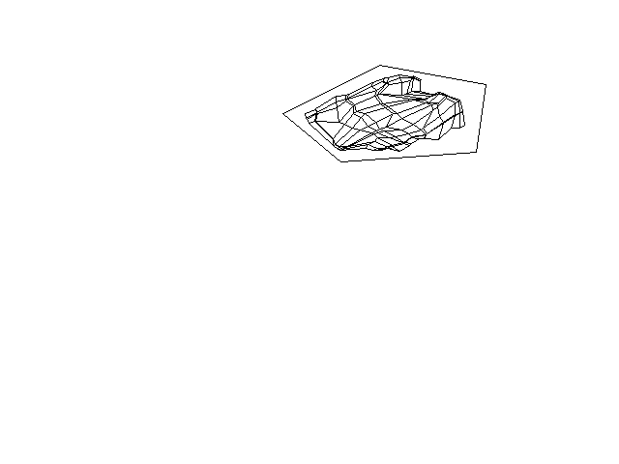
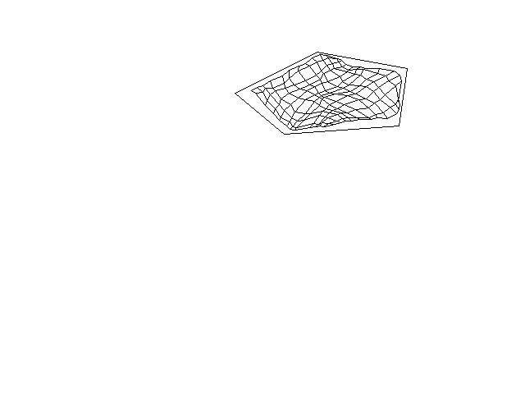
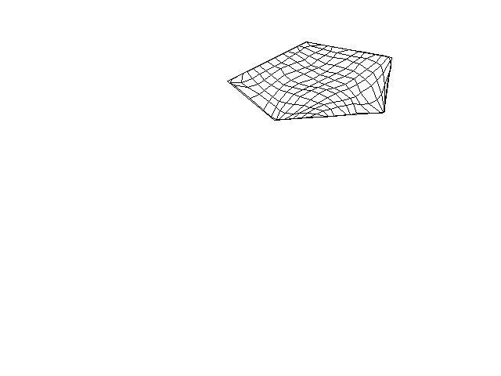
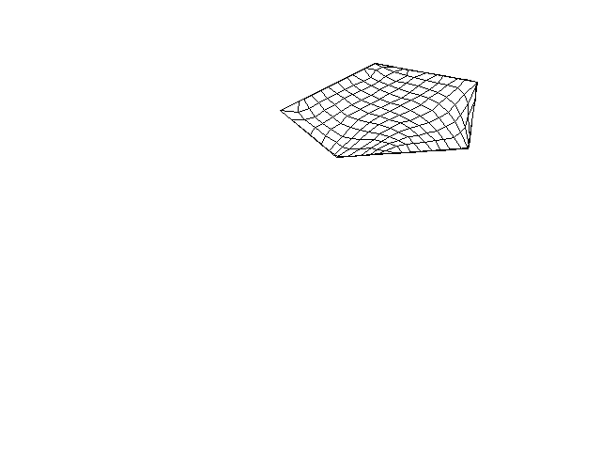
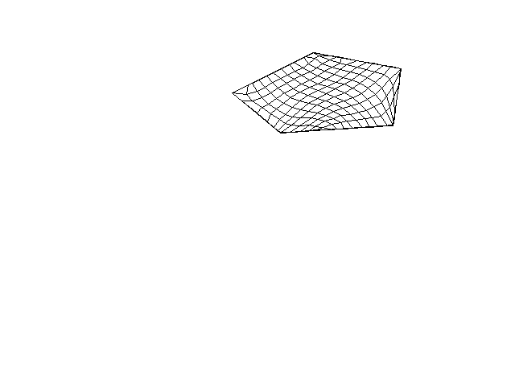
Placement of Mesh via Self Organizing NNs2
Iteration 0
Iteration 500;
Quality =288
Iteration 2000;
Quality = 238
Iteration 6000;
Quality =223
Iteration 12000;
Quality = 208
Iteration 30000;
Quality =202

Slide 22
(MaxNet)
1
1
−ε
−ε
An(0) := Input(n)
An(new) : = {An(old) – ε$\sum_{j≠n}{A_j} if>0$
0 otherwise
−ε
−ε
−ε
−ε
−ε
−ε
−ε
−ε
−ε
1
1
−ε

Slide 23
Reminder Independence and Correlations
Vectors a = (a1, a2, … an) and b = (b1,b2, … bn)
a and b are independent if a b = 0 (i.e. inner product; Σ(a_i b_i ) = 0 )
If we choose a from a set and b from a set the two sets are uncorrelated if the expectation of Σ(a_i b_i ) = 0. (That is, the average of such choices = 0.)
If normalized the inner product is between -1 and 1; like cosine so a metric between vectors.

Slide 24
Visualizing Weights and Vectors in Same Space

Slide 25
Hamming Net and Correlations
Hamming Distance between binary (or bipolar) vectors is the number of indexes in which they differ.

